Slide 1
A Text Analysis of Happiness

Slide 2
An Explanation
The idea behind this project was to see if the happiness ranking of a country as given by the 2017 Gallup poll was reflected in the happiness of the major literary works from that country
Did “unhappier” countries produce unhappier authors who wrote unhappier books?
Did countries differ in the types of words they used?
i.e. Would a country higher in happiness rank tend to write books with more “joy” and “trust” words as opposed to “fear” and “disgust” words?

Slide 3
2017 Happiness Data

Slide 4
The Happiest and Unhappiest Places
Rank | Country | Region | Happiness Score
1 | Norway | Western Europe | 7.54
2 | Denmark | Western Europe | 7.52
3 | Iceland | Western Europe | 7.50
4 | Switzerland | Western Europe | 7.49
5 | Finland | Western Europe | 7.47
6 | Netherlands | Western Europe | 7.38
7 | Canada | North america | 7.32
8 | New Zealand | Australia and New Zealand | 7.31
9 | Sweden | Western Europe | 7.28
10 | Australia | Australia and New Zealand | 7.28
146 | Yemen | Middle East | 3.59
147 | South Sudan | Sub-Saharan Africa | 3.59
148 | Liberia | Sub-Saharan Africa | 3.53
149 | Guinea | Sub-Saharan Africa | 3.51
150 | Togo | Sub-Saharan Africa | 3.49
151 | Rwanada | Sub-Saharan Africa | 3.47
152 | Syria | Middle East | 3.46
153 | Tanzania | Sub-Saharan Africa | 3.35
154 | Burundi | Sub-Saharan Africa | 2.9
155 | Central African Republic | NA | 2.69

Slide 5
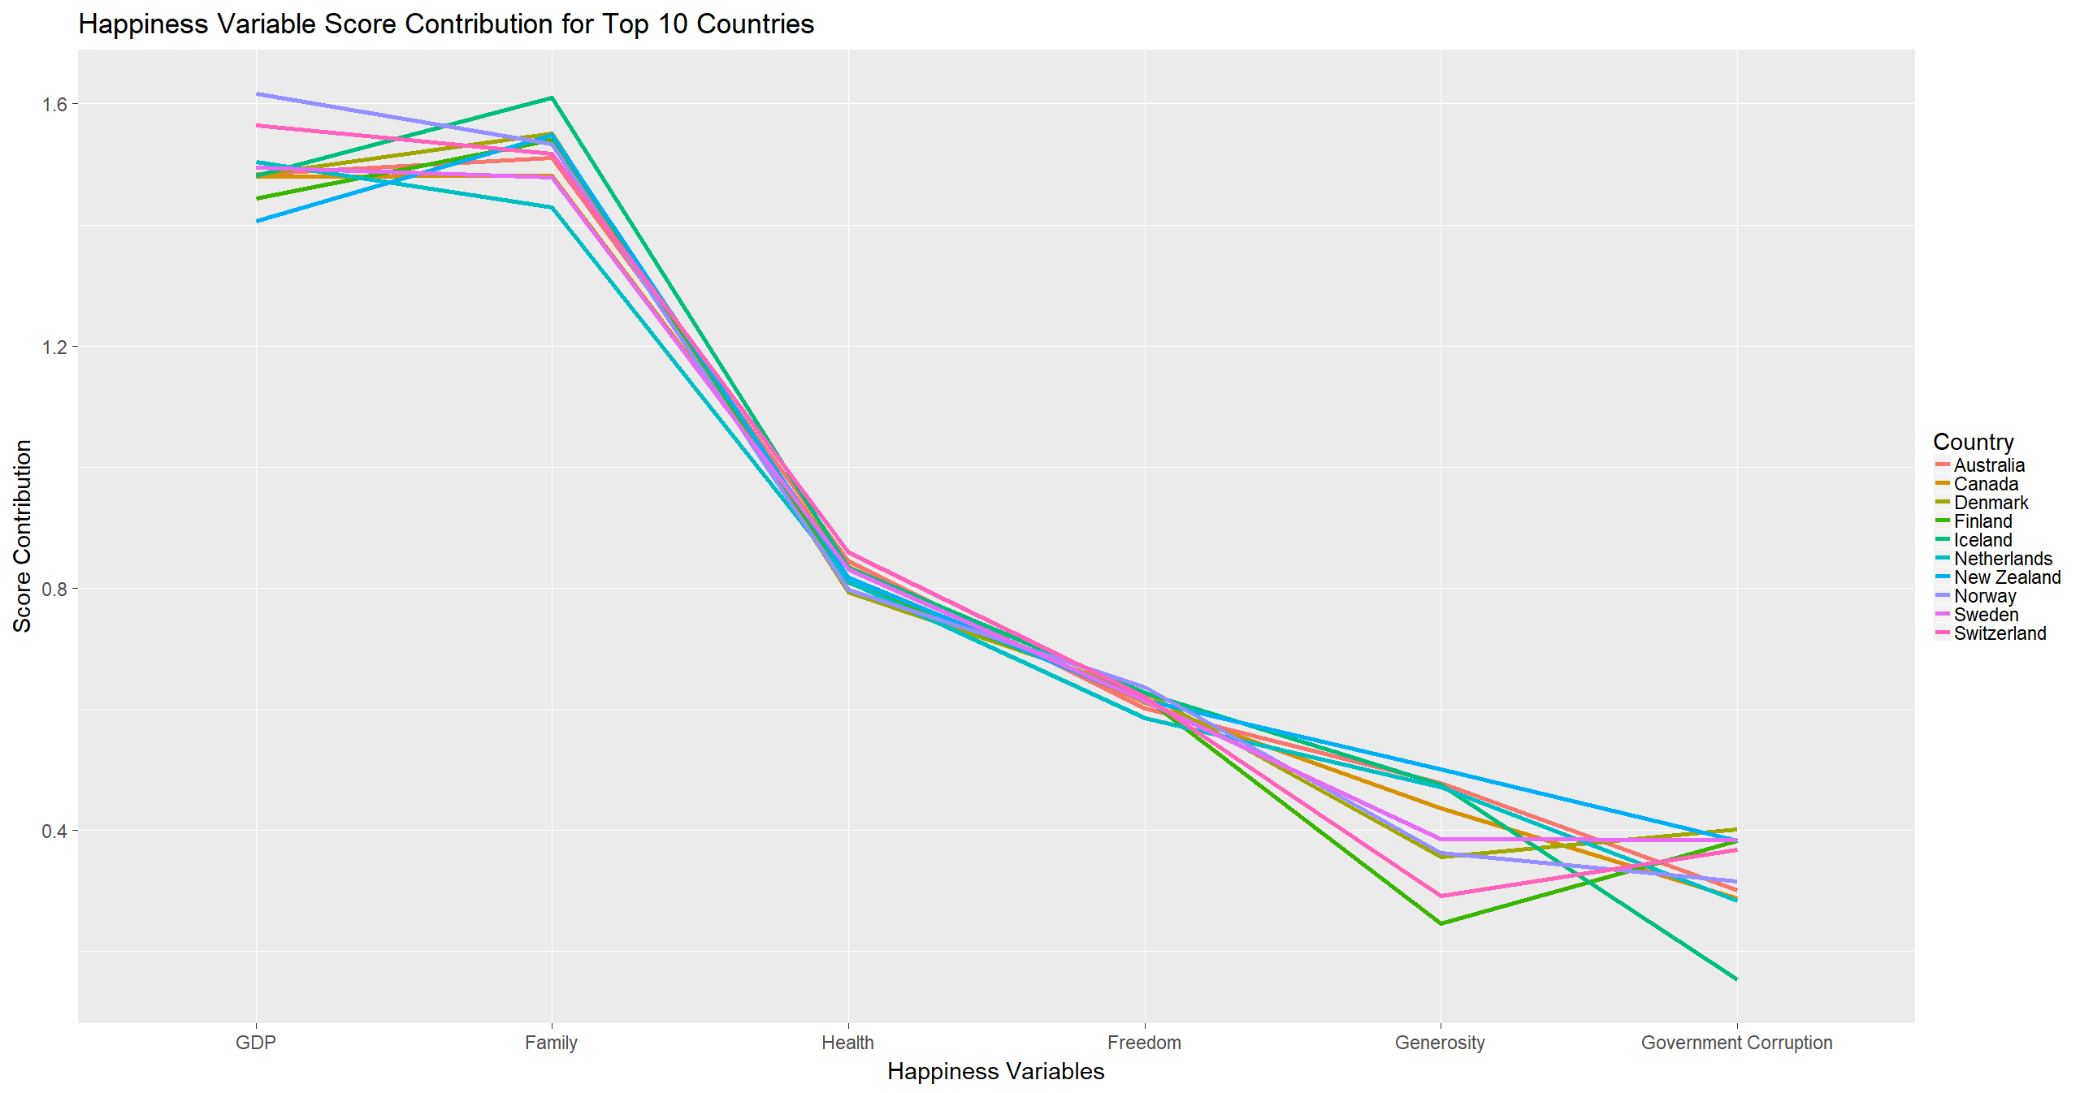
Top 10 Countries
The Top 10 happiest countries seem to agree on which variables contribute most to their happiness.
GDP and Family are top contributors, followed by Health, Freedom, Generosity and Government Corruption.

Slide 6
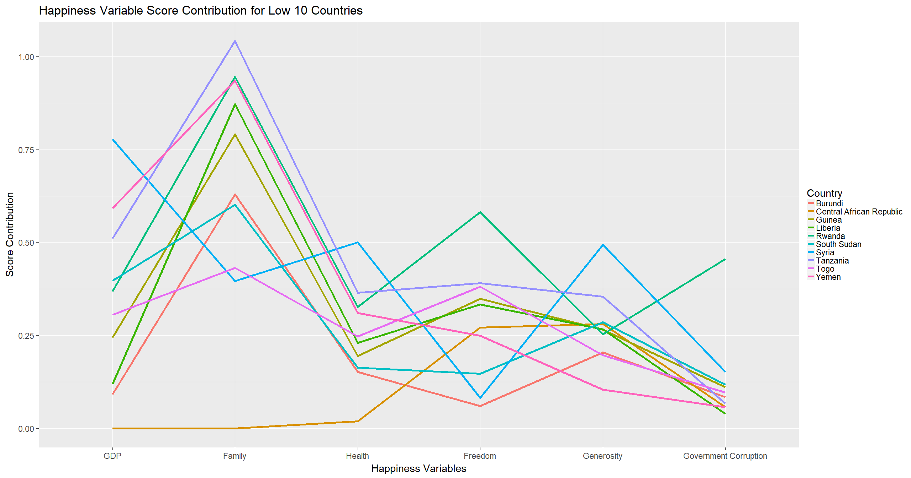
Low 10 Countries
The Low 10 happiest countries have much less consensus on what makes them happy.
GDP contributes far less than in the Top 10, while Family still remains important in both Top and Low 10.

Slide 7
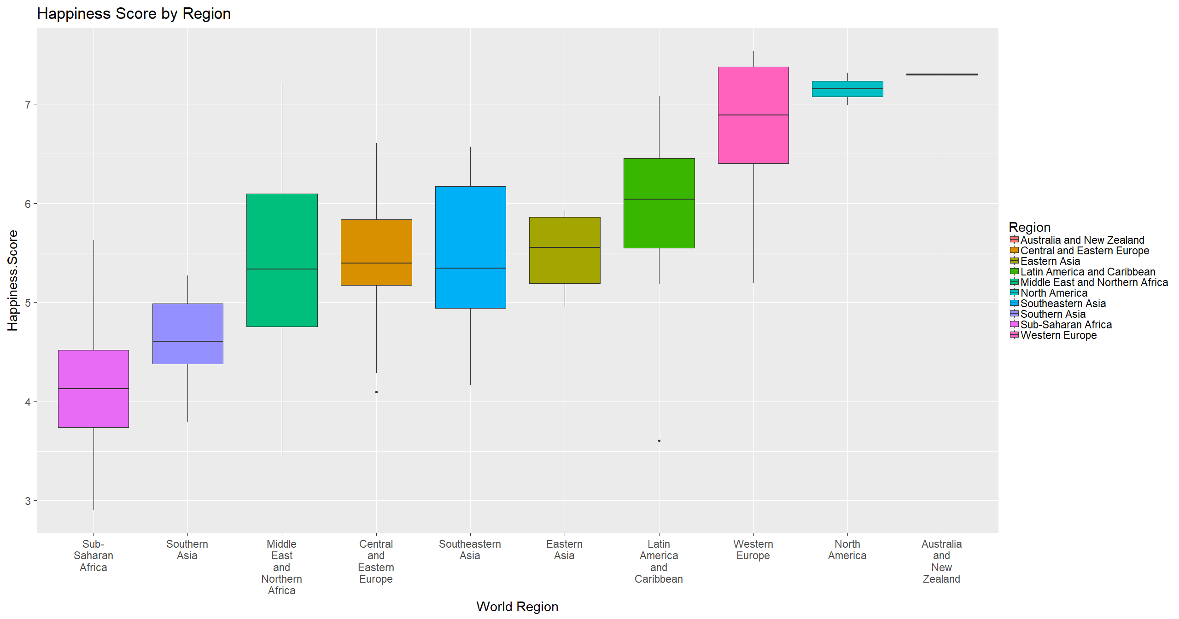
Happiness by Region

Slide 8
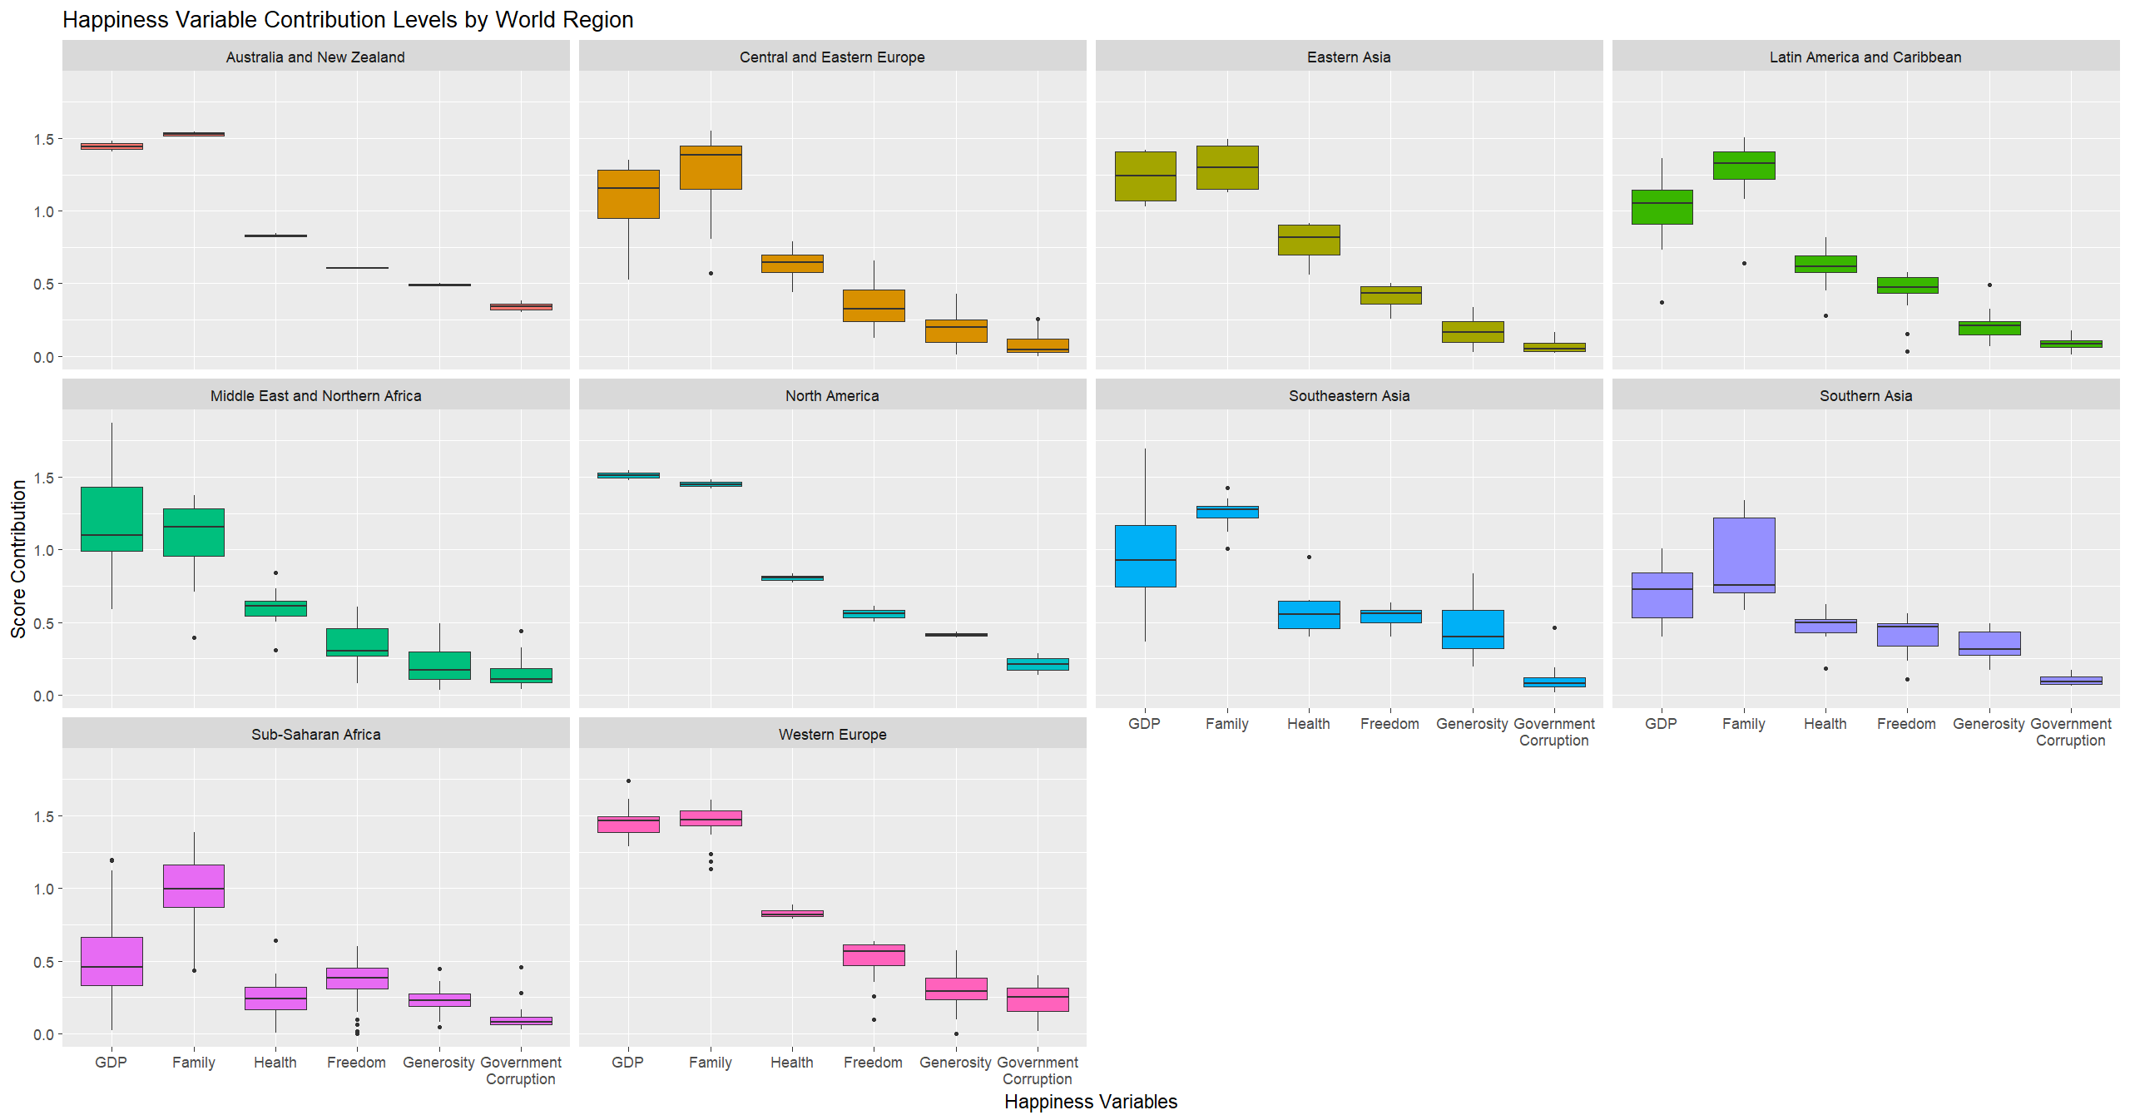
Happiness Variables by World Region

Slide 9
The next few slides will examine the happiness of the countries which I performed literary analyses for. They are:
Russia
The United States
France
Greece
United Kingdom

Slide 10
Happiness Overview
For the most part, the countries analyzed follow the ranking of Happiness variables shown by the Top 10 countries.
There are some surprising numbers like Generosity factoring 0 into people’s happiness in Greece, when generosity and hospitality are actually quite important cultural values.
It was also interesting to see how little Government Corruption factors into the happiness of the Greeks and Russians, two countries with notoriously corrupt governments. This makes sense, since if the government’s corruption affected people’s happiness too greatly, the country’s happiness score would be even lower.

Slide 11
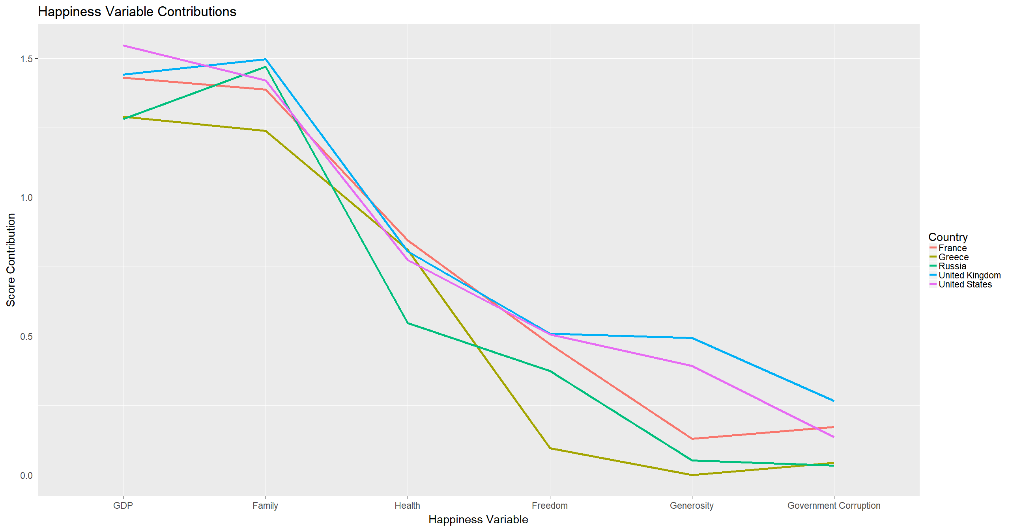
Happiness Overview

Slide 12
Literary Analysis

Slide 13
Method
For each of the five countries examined I scraped the Wikipedia pages of 20-30 of its most prominent authors. I then scored the pages using the AFINN lexicon for its positive vs negative sentiment. I reasoned authors with more negative biographies, probably led unhappier lives. Conversely, those with more positive biographies led happier lives.
I then used the R-Gutenberg package to score the major literary works of these authors using both the AFINN and NRC lexicons and assigned each author a “Mean Book Score” for the overall positivity/negativity of their body of work.
The NRC lexicon was used to find the proportion of words used by each author corresponding to emotions like “joy” and “fear”.
The AFINN lexicon was used since it applies a score to words ranging from -5 to 5. I found this lexicon more nuanced than the BING lexicon which simply categorizes words into 1 or -1 scores. For example, with BING, the phrase “tortured and exiled” would receive the same negative score as “unhappy and sad childhood” which I didn’t think was adequate.

Slide 14
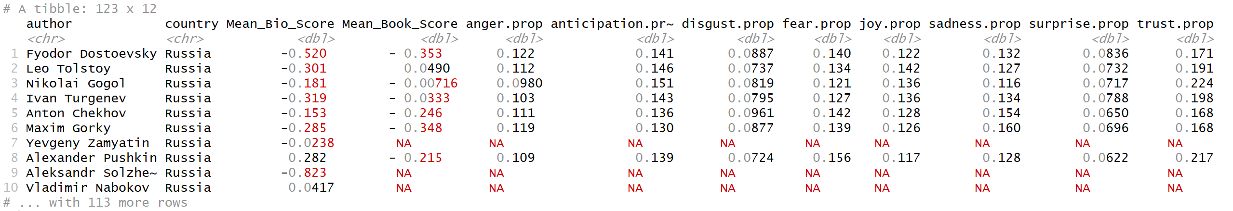
Snapshot of Authors and Biographies Table

Slide 15
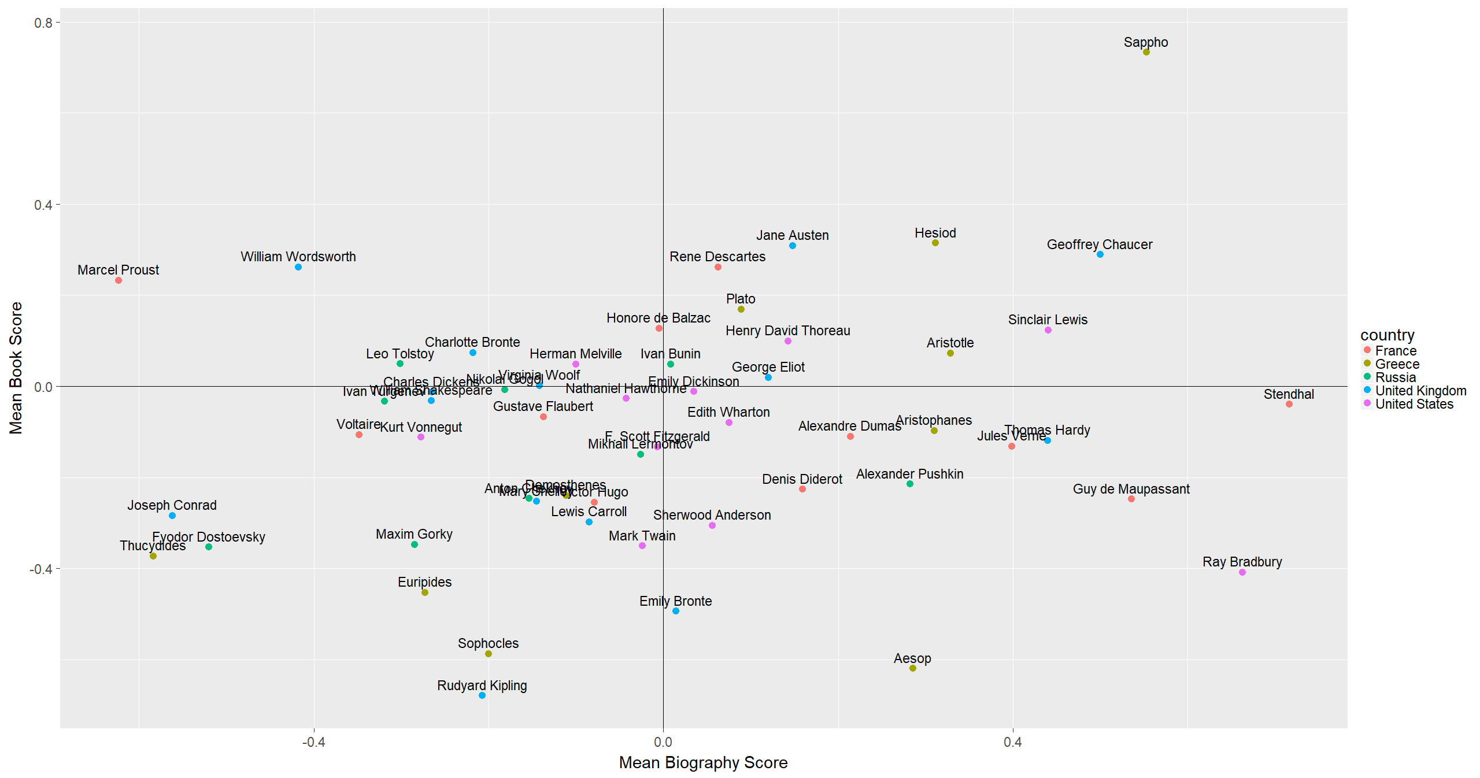

Slide 16
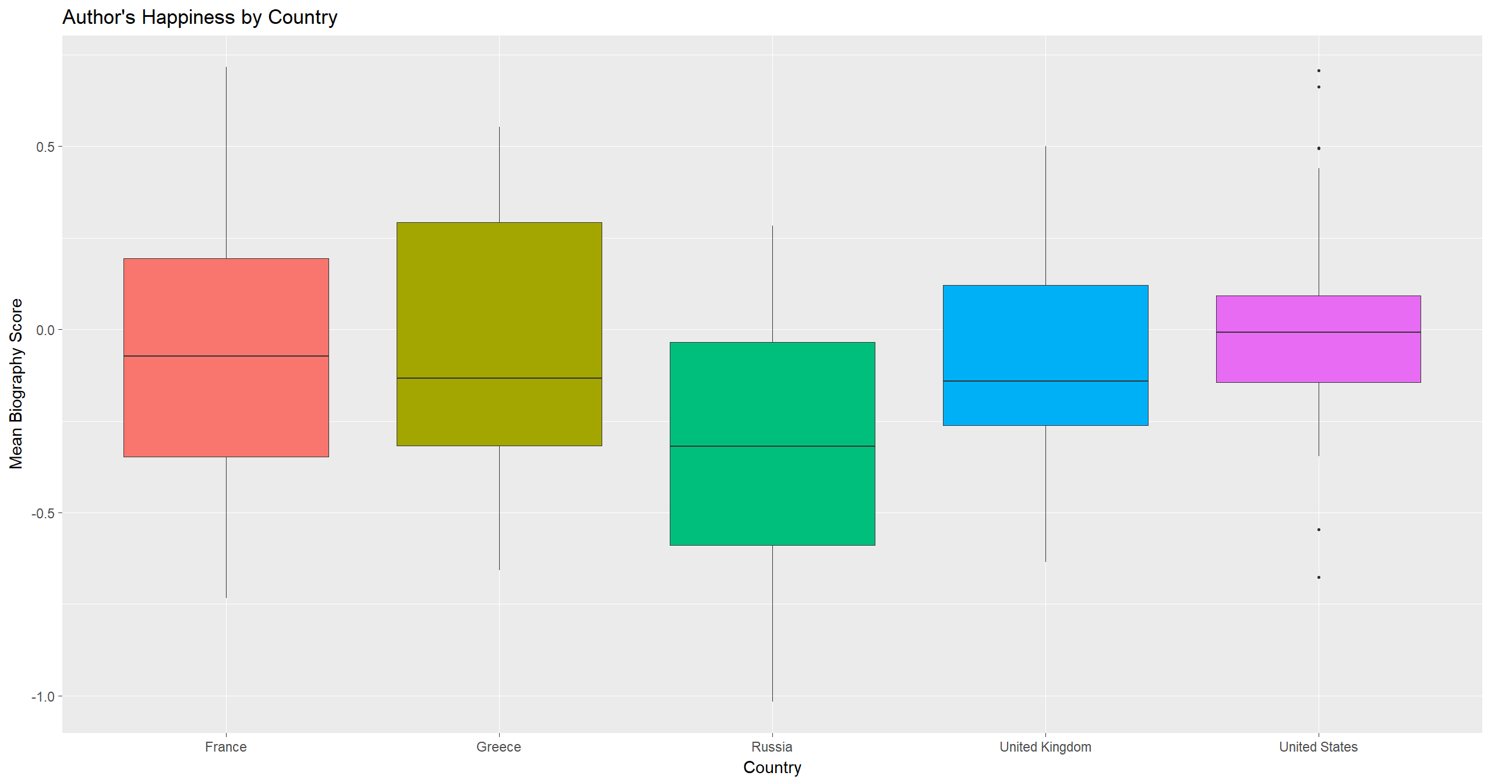
Author’s Happiness by Country
For the most part, the average happiness of the authors of these countries reflect their 2017 Happiness Ranking.
Russia and Greece hold the lower average author happiness. With the U.S on top.

Slide 17
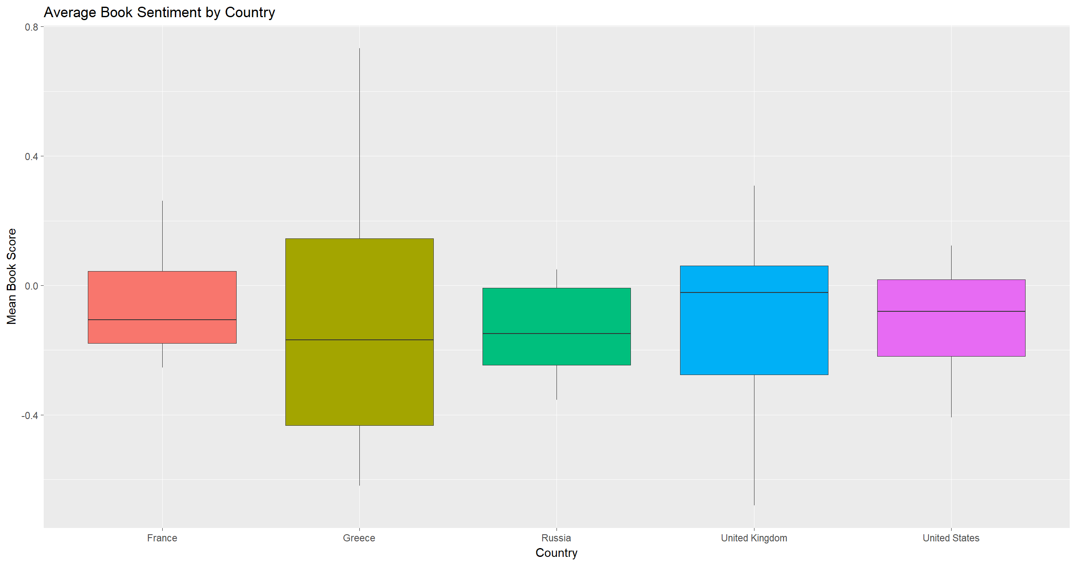
Averge Book Sentiment by Country
Of the books surveyed, each of the 5 countries major literary works average a negative sentiment.
The UK and US have slightly more positive books however, then Greece and Russia. Which one again seems to be reflecting the 2017 Happiness data.

Slide 18
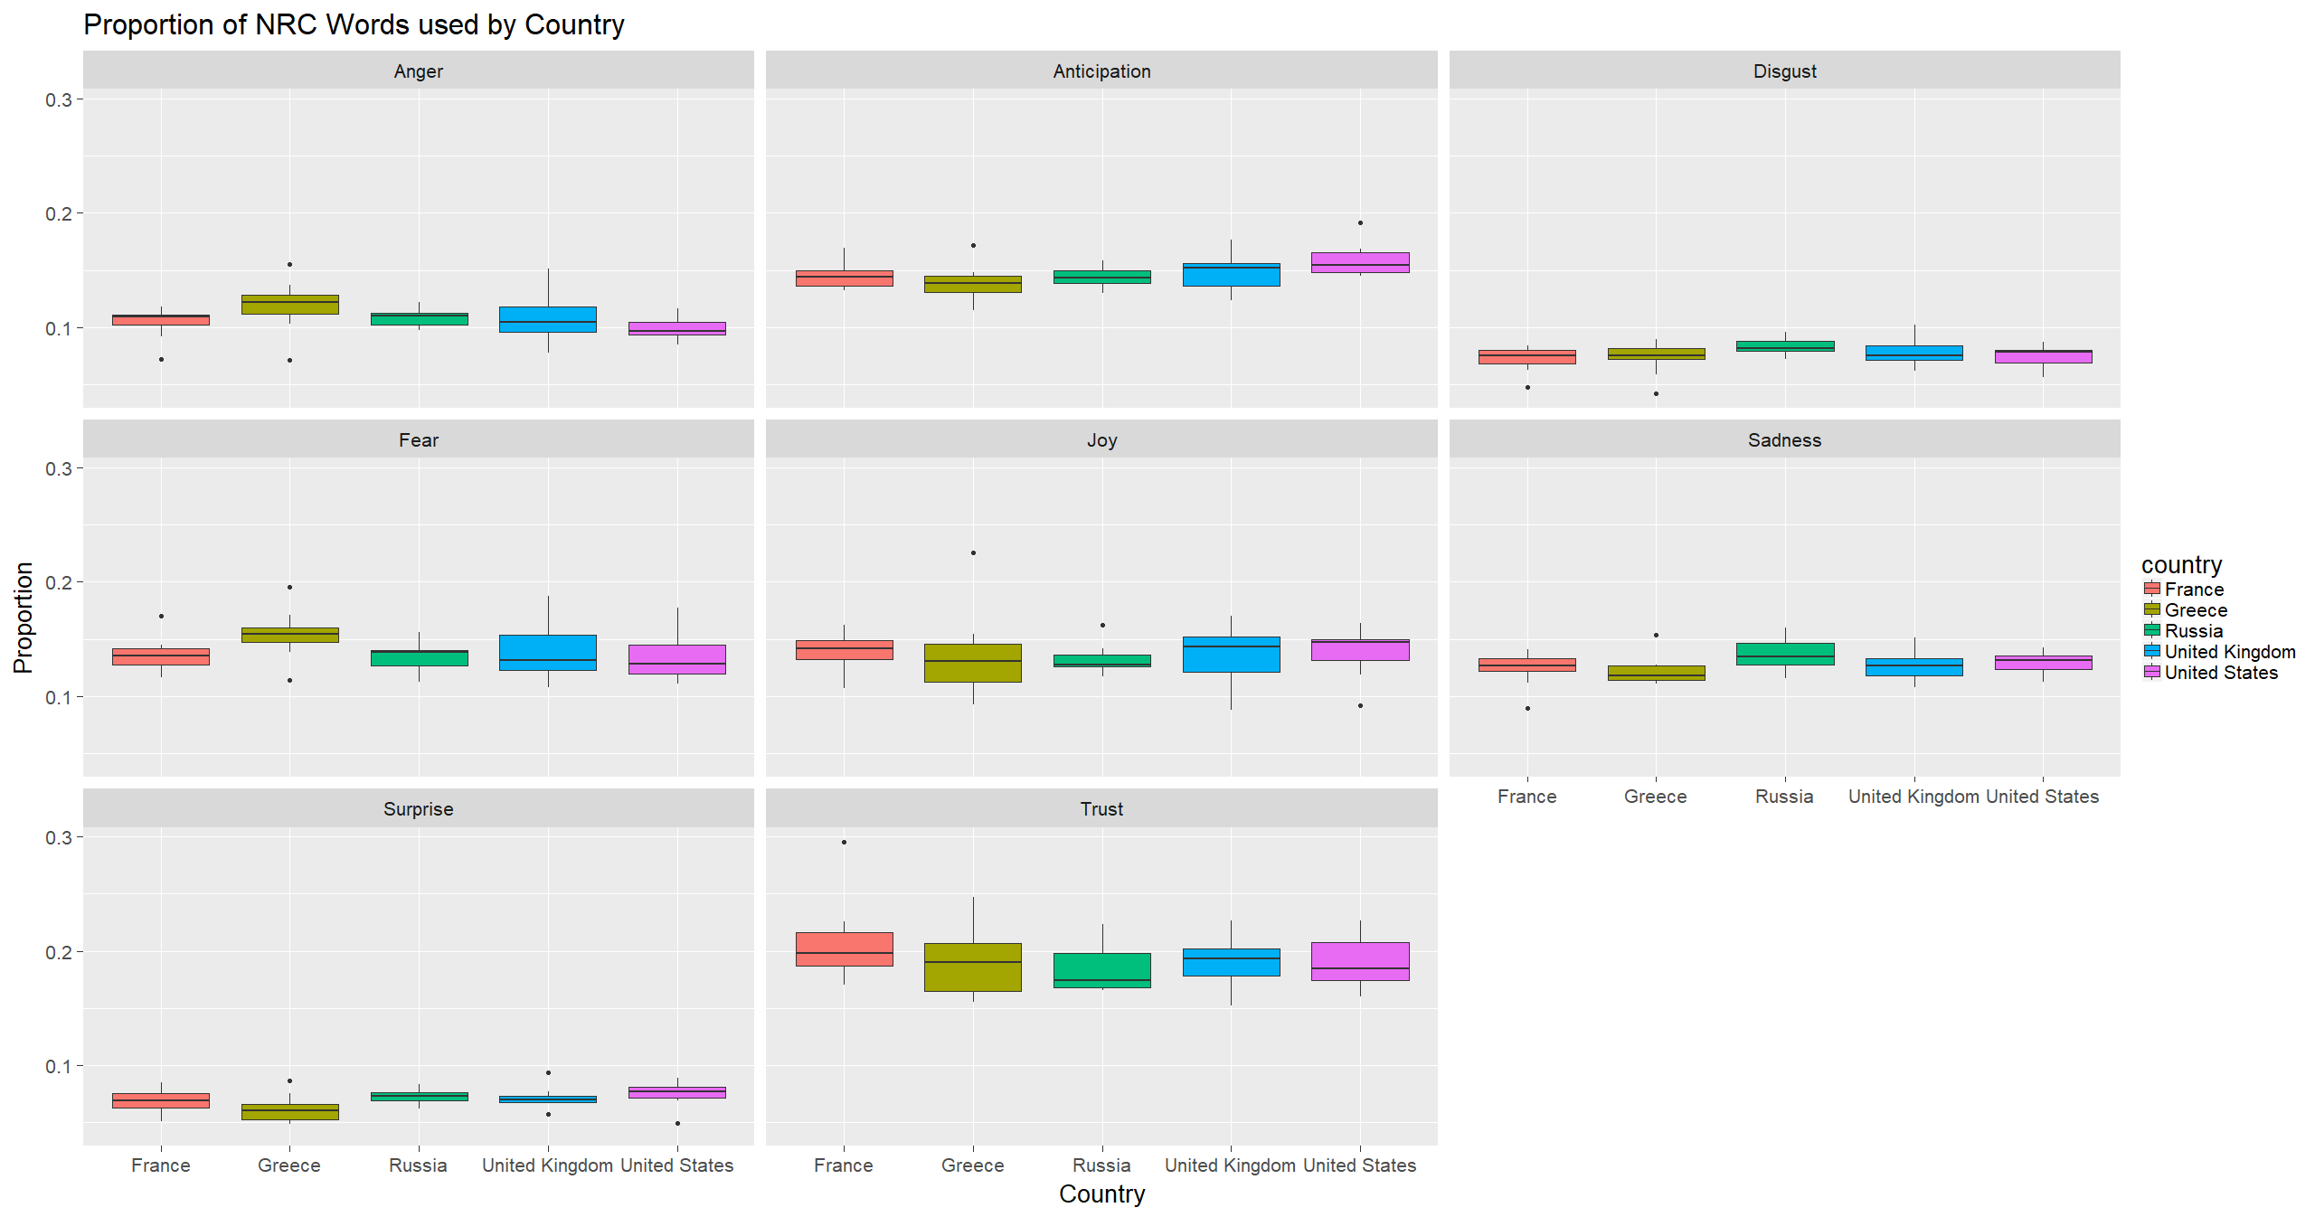
NRC Analysis

Slide 19
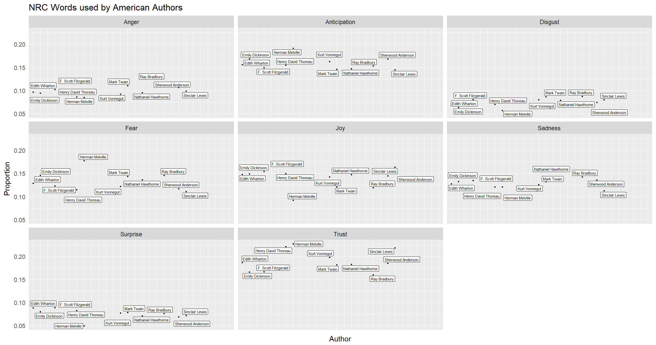
NRC Analysis – United States

Slide 20
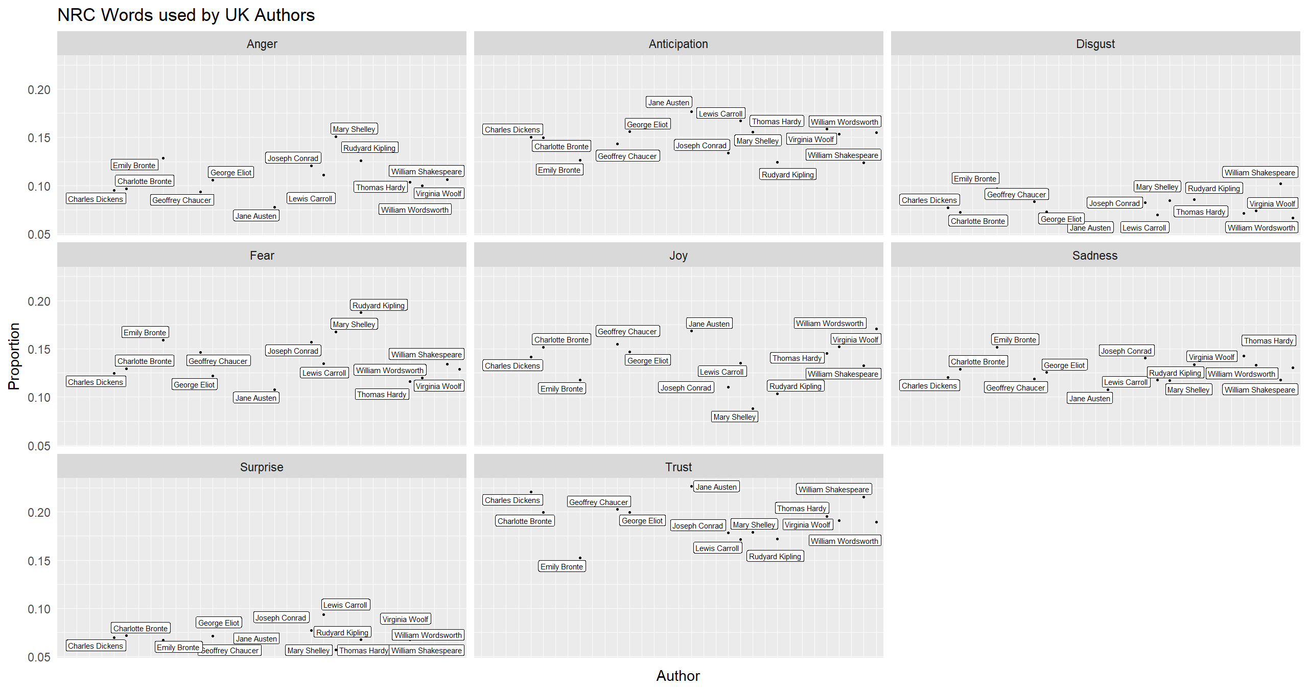
NRC Analysis – United Kingdom

Slide 21
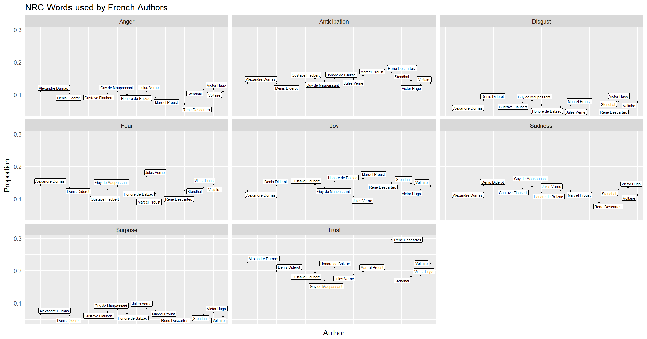
NRC Analysis – France

Slide 22
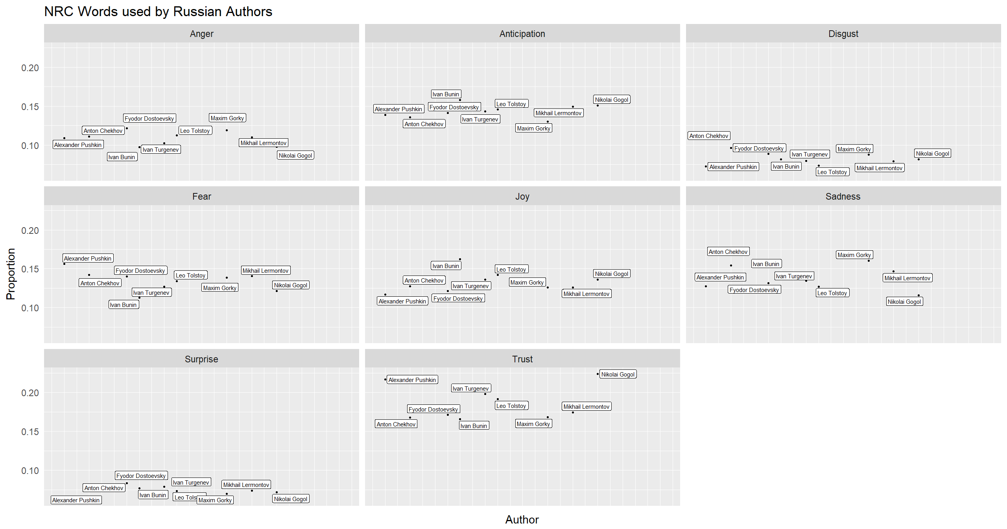
NRC Analysis – Russia

Slide 23
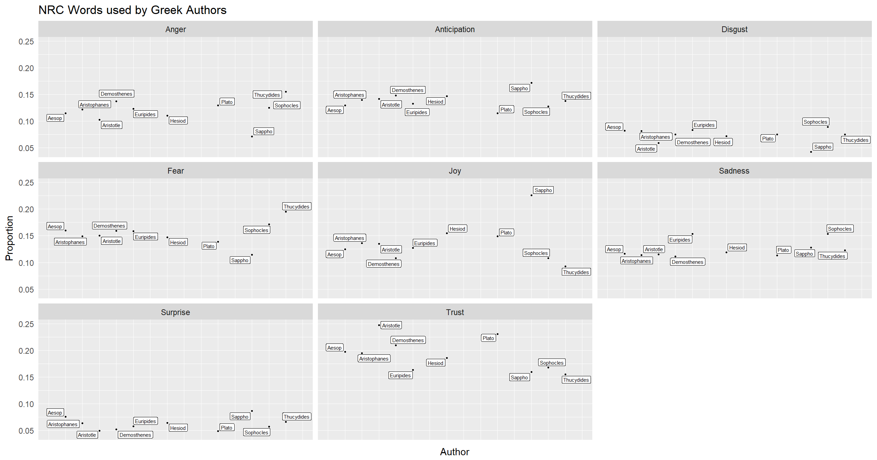
NRC Analysis – Greece

